Slide 1
Image2Text
Prepared By
Sanju Prabhath Reddy 15114042
Sri Harsha Majeti 15114044
Harsha Vardhan Miryala 15114045

Slide 2
Image Captioning
A short piece of text that describes an image .
In other words explains what the object(maybe people) in it is/are doing.

Slide 3
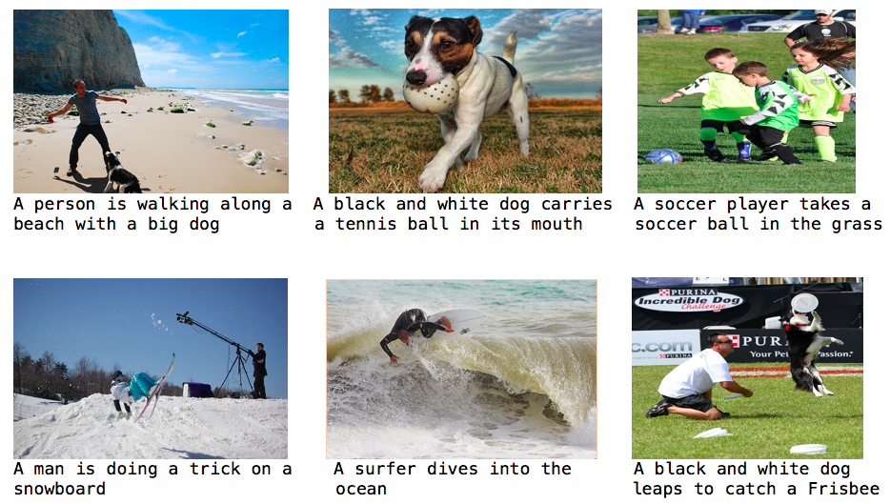
Examples

Slide 4
How we do ?
We use various techniques involved in
1. Computer Vision
2.Natural Language Processing (NLP)
OUR GOAL:
To give an overview about the general architecture which uses both
CV and NLP

Slide 5
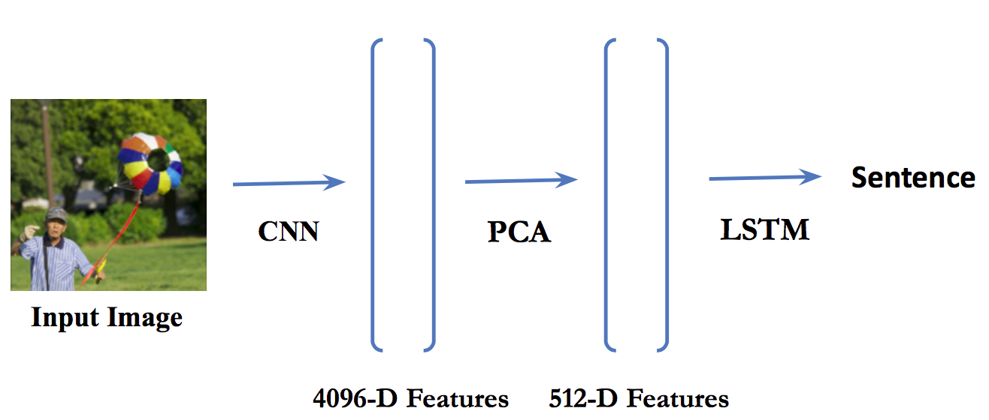
Overview

Slide 6
Model Architecture
Contains 3 components
1.CNN(Convolutional neural network) based feature extraction
2.PCA (Principal Component Analysis)
3.RNN(Recurrent neural network) based sentence generation

Slide 7
CNN

Slide 8

Traditional Neural Network

Slide 9
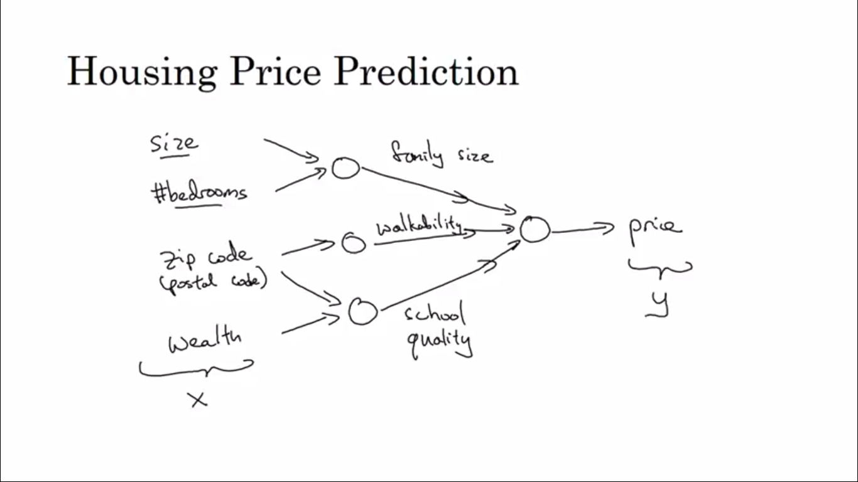
Example

Slide 10
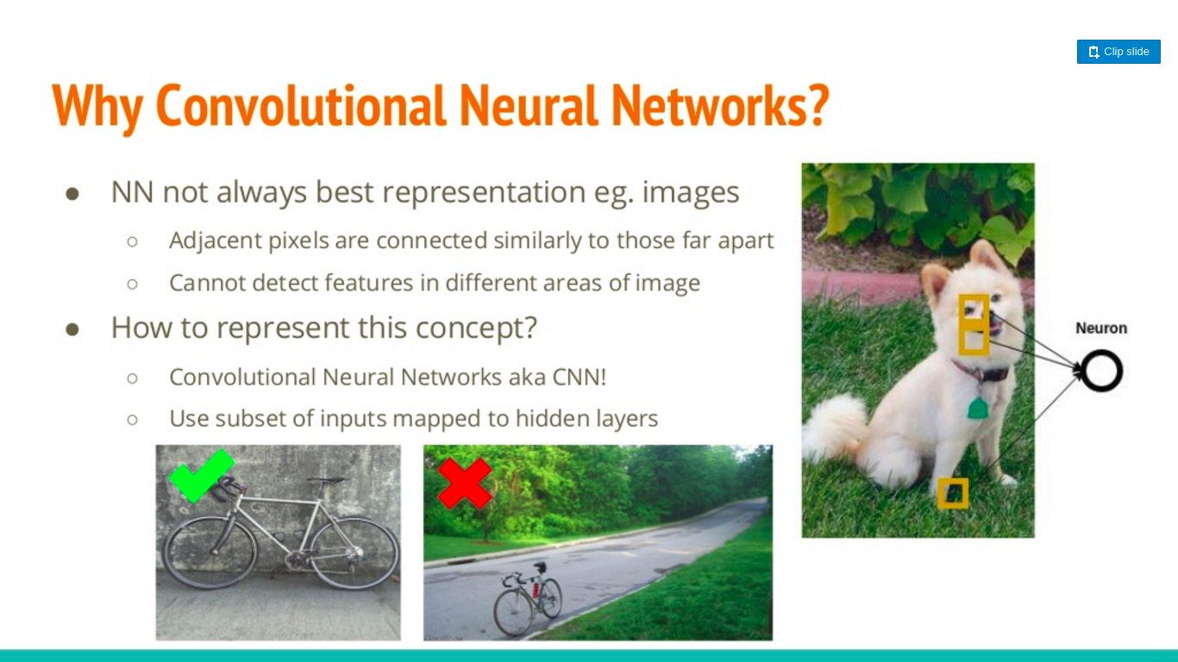

Slide 11
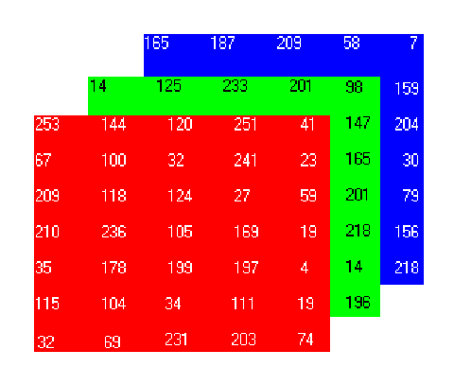
How a Computer sees an Image !

Slide 12
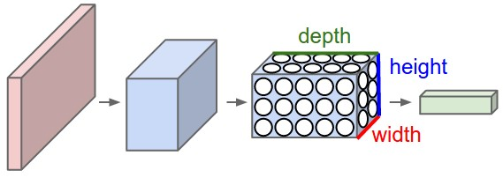
General Representation Of a CNN

Slide 13
Layers in CNN
Generally there are 3 layers in a CNN
1.Convolutional
2.Pooling
3.Fully Connected

Slide 14
What is convolution?
Example : Let’s take input image of 32*32*3
Let’s take filters of 5*5*3 size.Consider filter as a feature identifier(interpretation).
Slide this filter with stride 1 and find the sum of multiplication corresponding pixel values with feature values in the filter.
We get a matrix of 28*28*x if we take x such filters.
This process is called convolution..

Slide 15
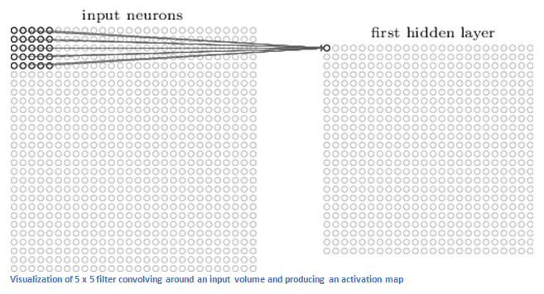

Slide 16
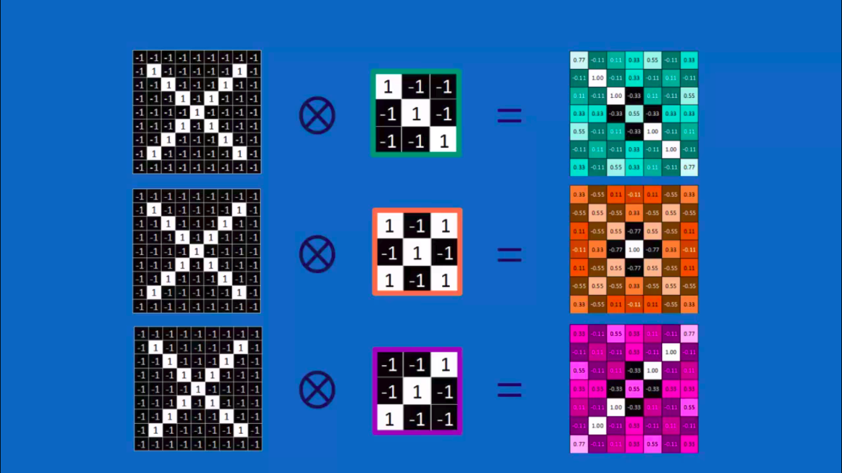

Slide 17
Pooling
2 kinds
1.Max Pooling
2.Average Pooling.

Slide 18
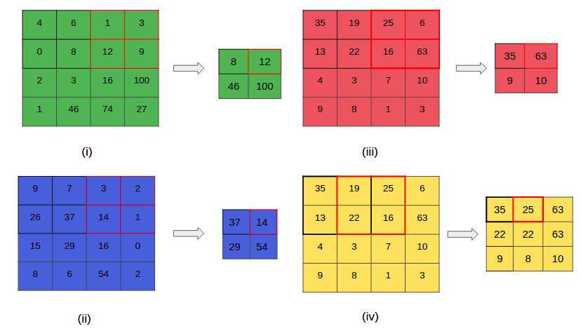

Slide 19
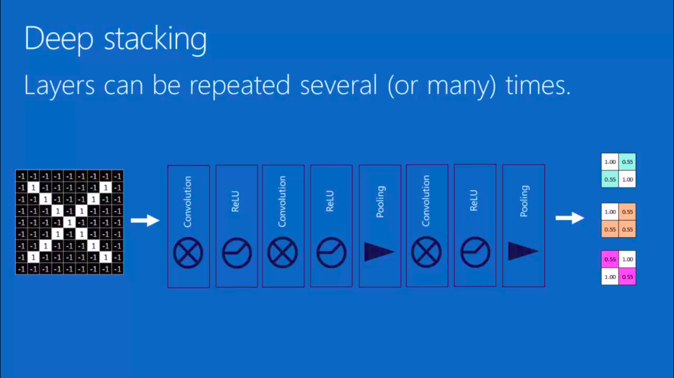

Slide 20
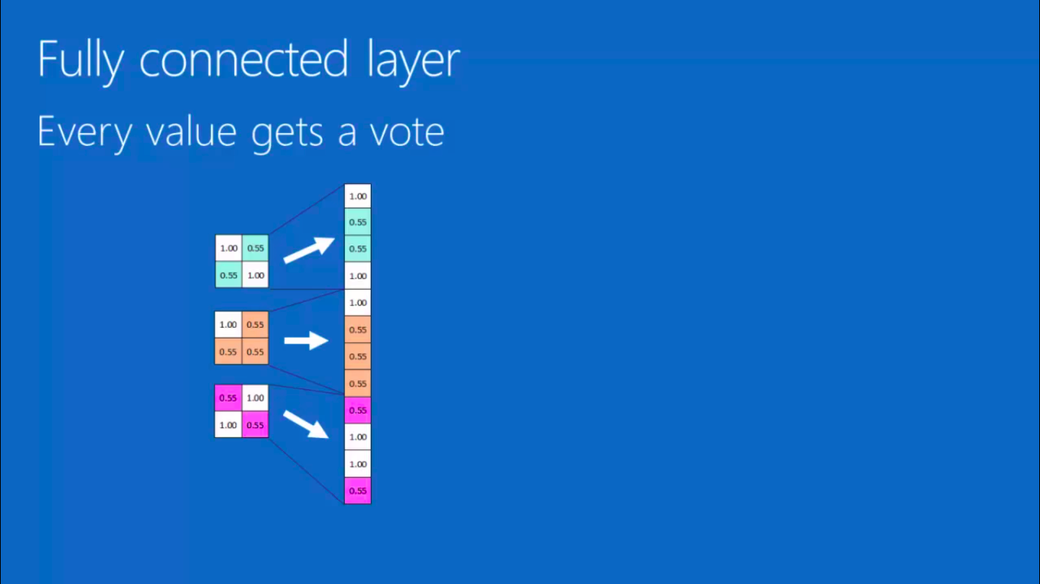
Fully connected Layer

Slide 21
Various Architectures
AlexNet
GoogLeNet
ZFNet
VGGNet
For our problem we used a VGGNet which gives a fully connected layer of 4096 features.

Slide 22

VGGNet

Slide 23
PCA

Slide 24
Principal Component Analysis(PCA)
Earlier we got a feature vector of 4096*1
We reduce this to 512*1
Why?
Due to the limitations of computational power.
To speed up our process before we pass it to LSTM or RNN

Slide 25
What is PCA??
PCA is a dimensionality reduction algorithm that can be used to significantly speed up our feature learning algorithm.

Slide 26
What does PCA do?
Identifies patterns in data
Finally expresses the data in a way that highlights similarities and differences

Slide 27
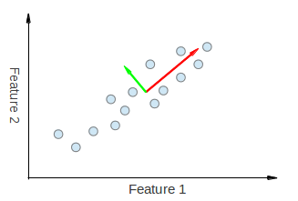
Given Example

Slide 28
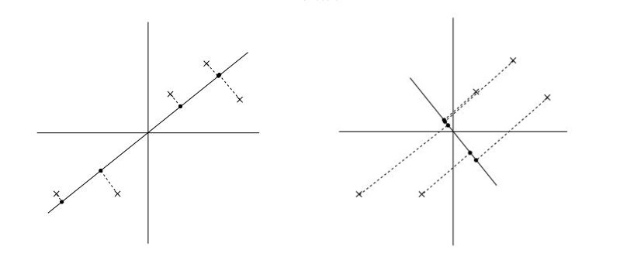
Minimize Projection Error

Slide 29
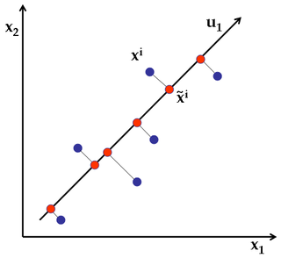

Slide 30
Data Preprocessing
Normalisation of mean and variance
1. Replace ​ ​each ​ ​x ​ ​(i) ​ ​with ​ ​x ​ ​(i) ​ ​− ​ ​µ
2. ​Replace ​ ​each ​ ​x ​ ​(i) ​ ​j ​ ​with ​ ​x ​ ​(i) ​ ​j ​ ​/σj ​ ​
​ where,
µ - mean
σj -​ ​​standard ​ ​deviation ​ ​of ​ ​the ​ ​input ​ ​training ​ ​examples

Slide 31
Variance
PCA tries to retain most of the variance even after heavily reducing dimensions
​PCA did not manipulate data. It just made sure that we use feature vectors that approximately represent the original data by retaining more than 95 or 99% originality of our actual input data

Slide 32
Word Embeddings

Slide 33
Word Embeddings
A Word Embedding : word(W)→vector(V) is a parameterized function mapping words in some language to high-dimensional vectors.
For example, we might find:
W(‘‘cat")=(0.2, -0.4, 0.7, ...) a 300 dimensional vector
W(‘‘mat")=(0.0, 0.6, -0.1, ...) a 300 dimensional vector
Now how do we obtain this representation ?

Slide 34
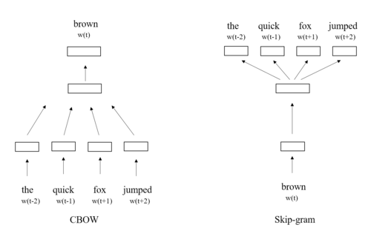
Learning Representations
Two good ways,

Slide 35
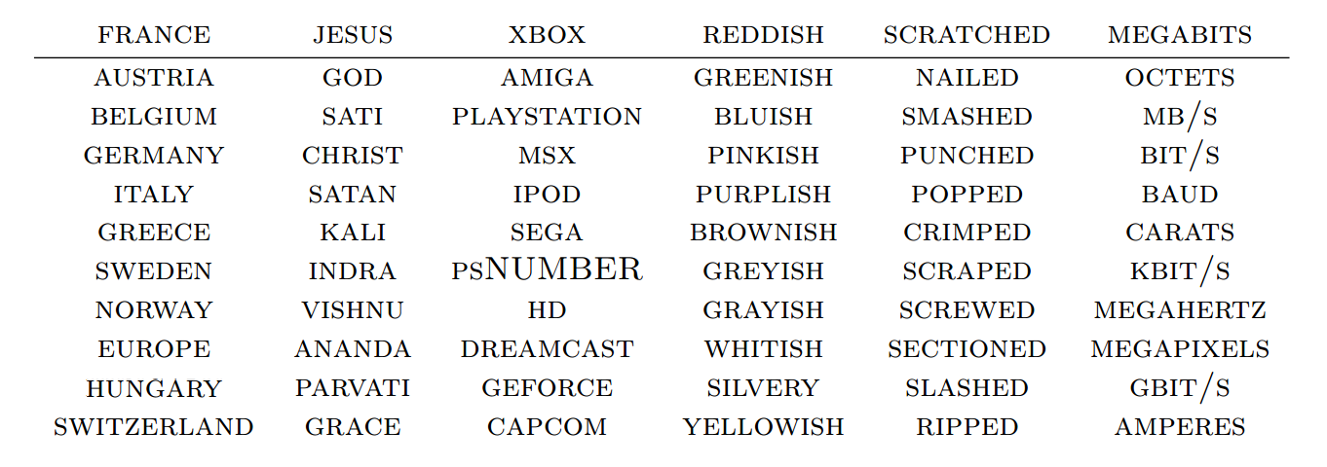
Nearest Words

Slide 36
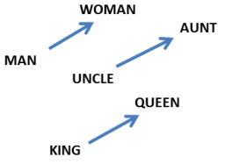
Capturing Relations
W(‘‘woman")−W(‘‘man") ≃ W(‘‘aunt")−W(‘‘uncle")
W(‘‘queen")−W(‘‘king") ≃ W(‘‘woman")−W(‘‘man")

Slide 37
LSTM

Slide 38

Simple RNN
Works well with short term dependencies but not with long term dependencies

Slide 39
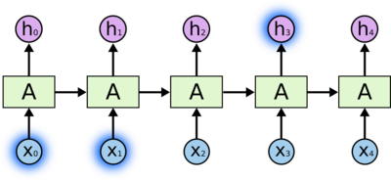
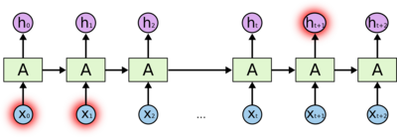
Problem with Simple RNN
Short-Term Clouds are in sky.
I live in France. .……..
Long-Term I am fluent in _____.

Slide 40
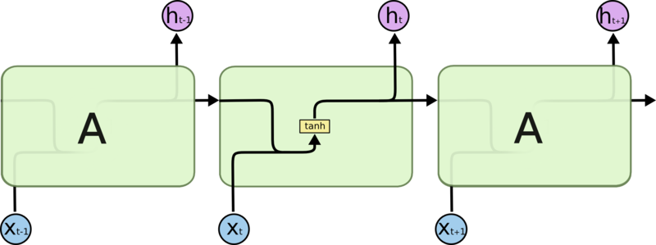
Vanilla RNN

Slide 41

LSTM

Slide 42
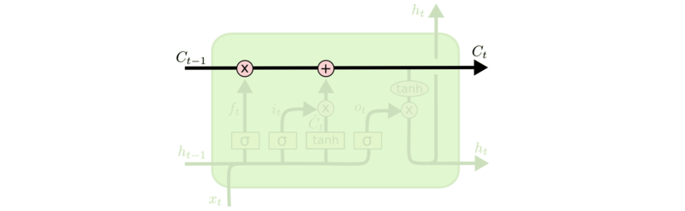
Why Long-Term ?
The key to LSTMs is the cell state, the horizontal line running through the top of the diagram.
It’s very easy for information to just flow along it unchanged

Slide 43
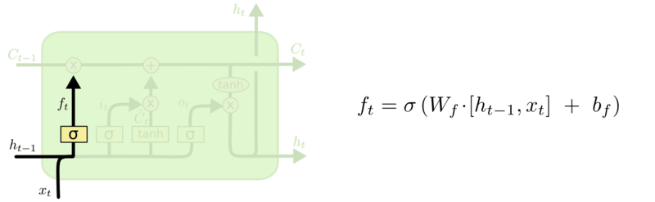
Forget Part

Slide 44
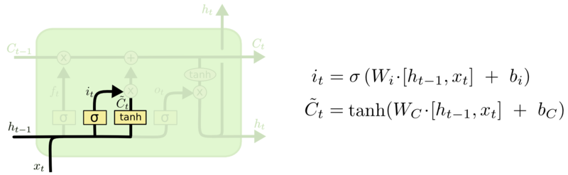
New Info Part

Slide 45
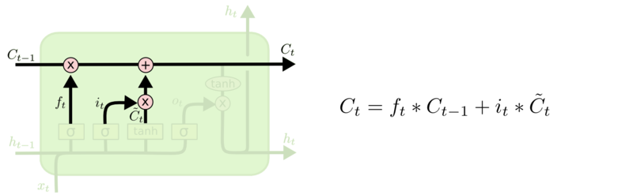
Adding the Two

Slide 46
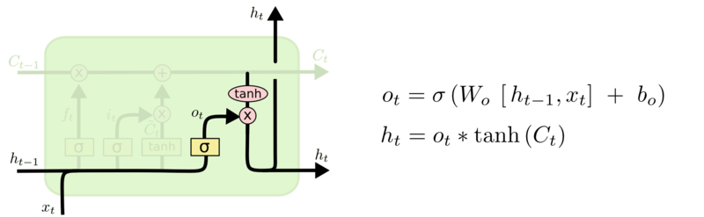
Output

Slide 47
Model Working

Slide 48
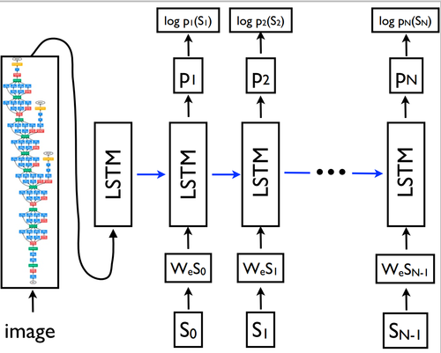
Final Model
S₀ → START word
S_{n} → END word
x₋₁ = CNN(I)
x_{t} = W_{e}S_{t}, t ∈ {0 . . . N − 1}
p_{t+1} = LSTM(x_{t}), t ∈ {0 . . . N − 1}

Slide 49
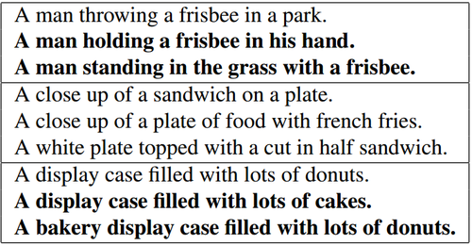
Training and Evaluation
Since all sentences mean the same thing we can’t have evaluation function which checks word by word.
Hence, a metric called BLEU score will be used which checks presence or absence of particular words as well as ordering, or we could ask human evaluators to assign a score based on appropriate captioning.

Slide 50
Summary

Slide 51
Conclusion

Slide 52
Conclusion ..contd.
We have presented a deep learning model that automatically generates image captions. Our described model is based on a CNN that encodes an image into a compact representation, followed by a RNN that generates corresponding sentences based on the learned image features. The generated captions are highly descriptive of the objects and scenes depicted on the images.

Slide 53
Applications
Smartphones made it possible for the visually impaired to take images of their surroundings. These images can be used to generate captions that can be read out loud to give visually impaired people a better understanding of their surroundings.
Social media platforms like Facebook can infer directly from the image, where you are ( beach, cafe etc), what you wear (color) and what you’re doing also (in a way) when you upload a image.
Can be extended to Video Captioning with some extra work.

Slide 54
The End

